Slide 1


Inventory Tracking
Lê Trần Ái Sa

Slide 2






Table of contents
Overview of Inventory
Identify Inventory Issues
Provide some actions

Slide 3

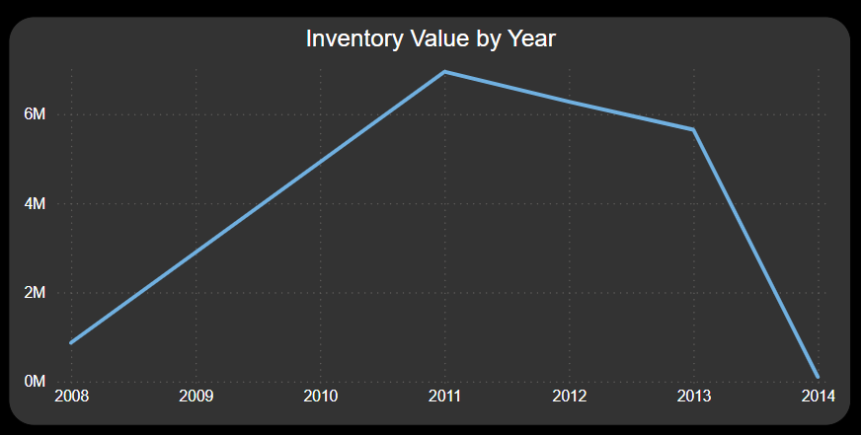
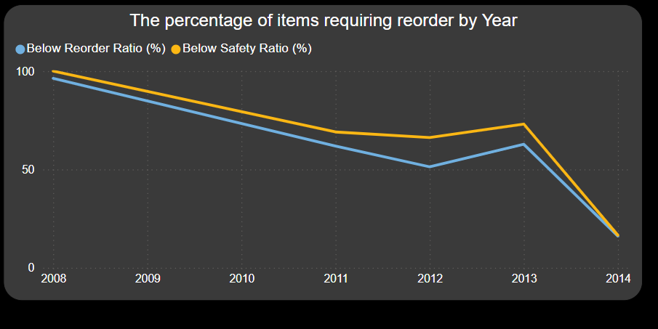
Overview of Inventory
The Inventory to Sales ratio approaches zero, signaling an inventory shortage relative to revenue. Besides, in 2014, there was an enhancement in inventory management, as ratios below the reorder and safety points decreased.

Slide 4
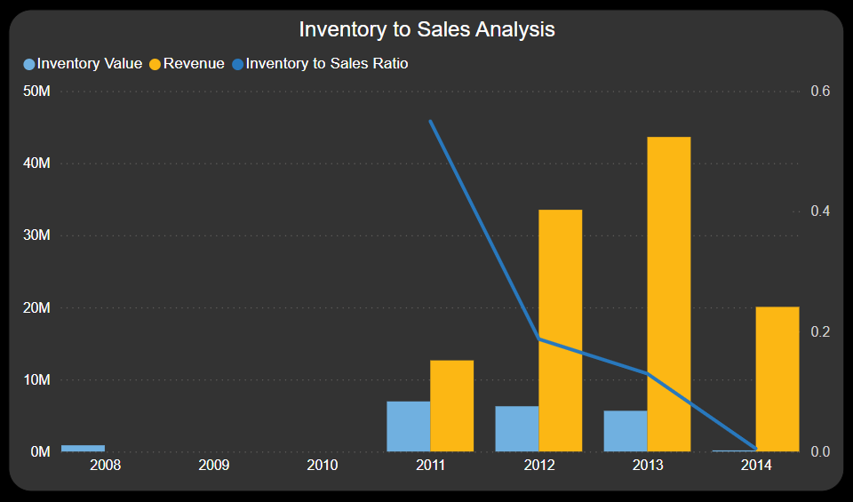
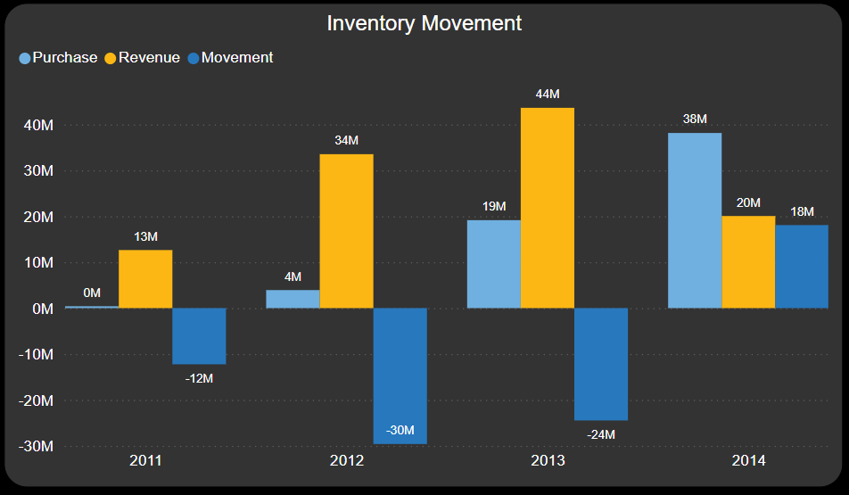
Identify Inventory Issues
The value of purchased inventory exceeds sales; however, at the reporting date, the inventory value is deficient, amounting to less than 1 million. This discrepancy may result from inventory counting errors, sales activity errors, or inventory loss.

Slide 5
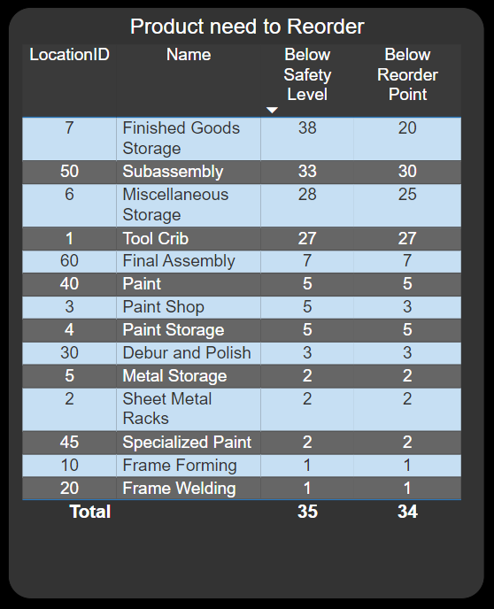

Provide some actions
Conduct an inventory recount.
Reorder items that have fallen below the reorder point and safety levels.

Slide 6

THANK YOU!

